Slide 1

ELDERLY FALL DETECTION
DONE BY: UNDER GUIDANCE OF
1. LATHIKA S Mr. NAVEEN R,
(7376212AD157) MENTOR,
2. HARISMITHA S BIT,
(7376212AD140) SATHY.
3. JOSHIHA MA
(7376212AD146)
4. BHAVANA K
(7376212AD118)

Slide 2

WORLD IoT DAY 2022
ABSTRACT
Due to the vast development of the medical field the death rate of elderly people has decreased. In this modern era, people are running behind jobs and the elderly people are left alone and also in Nursery homes. In such cases, they may accidentally fall due to their instability, other environmental conditions and get hurt, and in some cases, they may lead to death. Based on the previous findings, this project utilizes the modern technology in software and hardware to monitor the health condition and fall detection of an elderly people. Further, during the fall or emergency condition, the alarm and automatic call/message to relatives/Doctor will be activated. The proposed device is cost effective and more feasible device for the elderly/needy people.

Slide 3
WORLD IoT DAY 2022
Problem Statement
This project is an IOT based device that detects the falls of elderly people and monitors their health consistently.

Slide 4
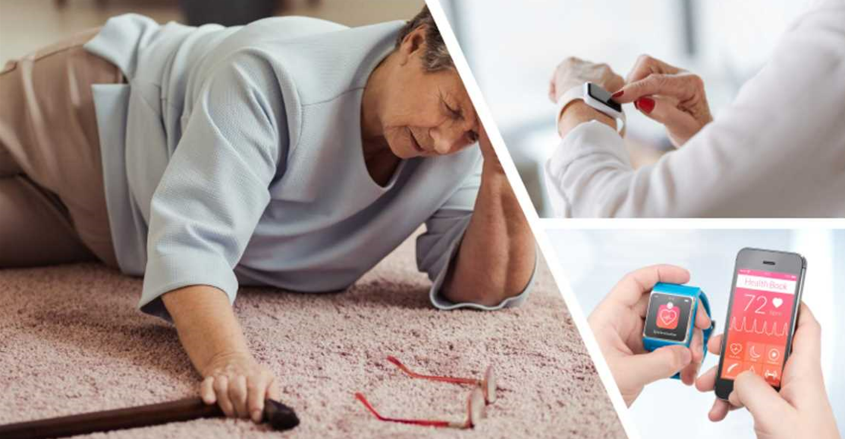
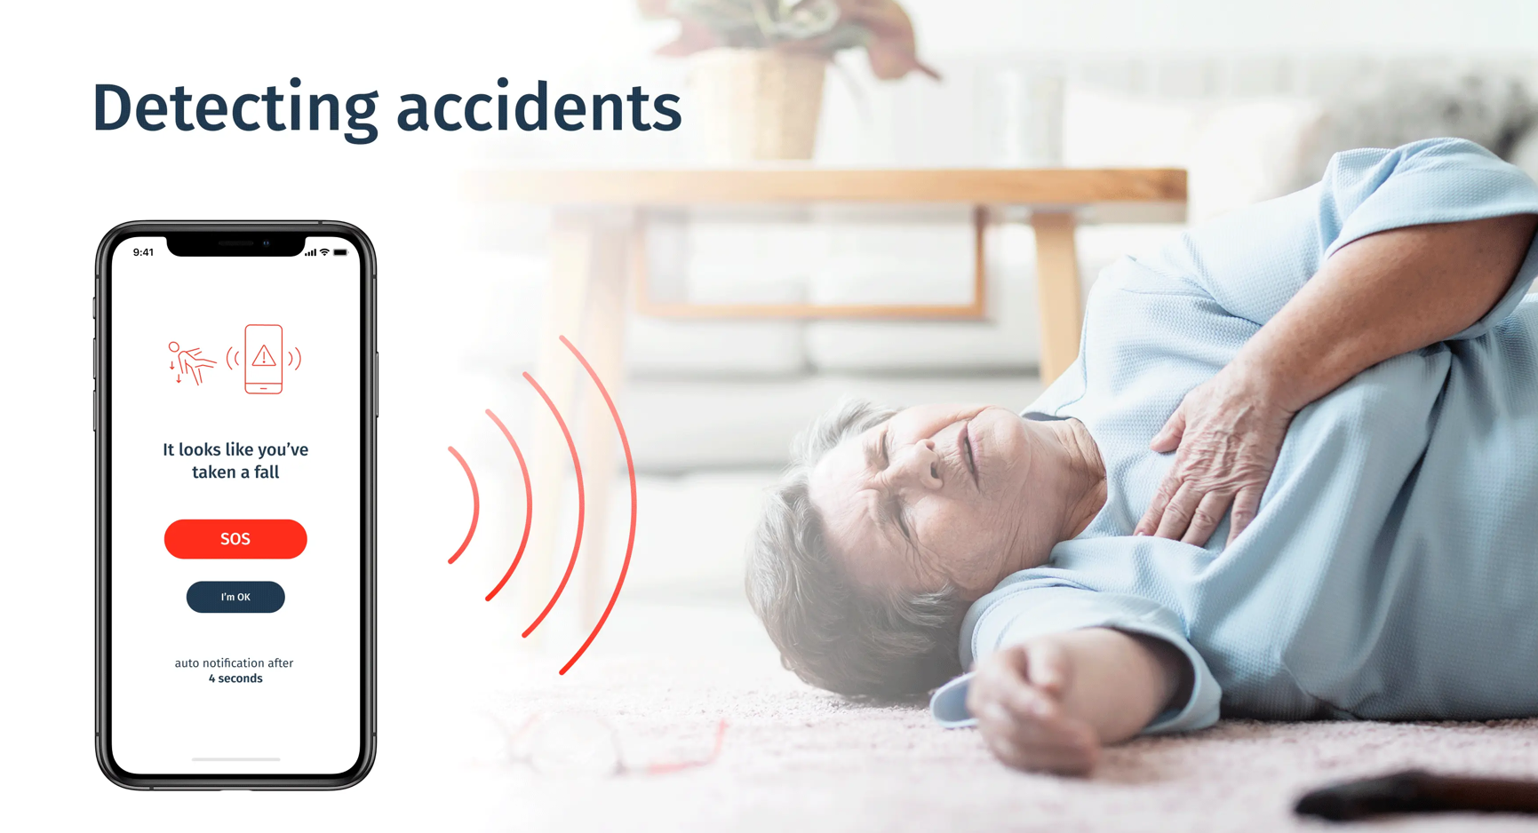
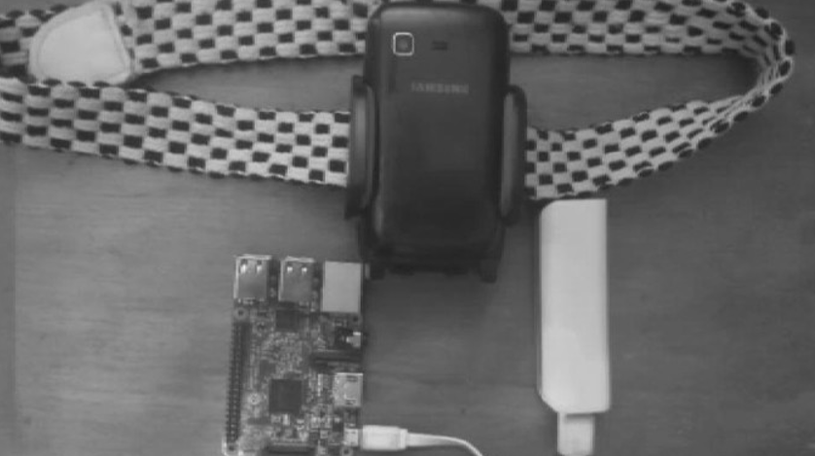
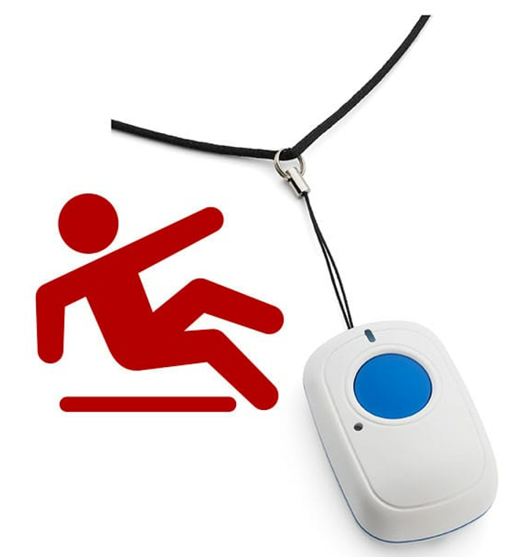
WORLD IoT DAY 2022
Existing Solution to the Problem Addressed
There are many solutions to the problem but nothing has a complete solution
Examples:
ELDERLY FALL DETECTION WATCH
ELDERLY FALL DETECTION APP
ELDERLY FALL DETECTION BELT
ELDERLY FALL DETECTION BUTTON

Slide 5
WORLD IoT DAY 2022
Concept of the solution
This project is a “Fall detection watch” based on the concept of sensors.
When the accelerometer in the watch senses a fall and the user doesn’t respond, an emergency call will be sent to the emergency contacts.
It has lithium rechargeable batteries as well as some tiny batteries in case of an emergency.
This watch monitors the environment and the location history through GPS and sends notifications to the user via an inbuilt voice assistant that recognizes the user's speech.
This device features a vision-based sensor as a tie pin that detects road bumps and dents and alerts the wearer so that they can walk alone.

Slide 6
WORLD IoT DAY 2022
Novelty / Scope of Solution
This project employs both the temperature sensor and the vision-based sensor.
The temperature sensor detects the user's body heat and activates the watch if the user is human.
The vision-based sensor detects road bumps and damages and alerts the user.
These two developments may aid in reducing the frequency of false alarms.

Slide 7
WORLD IoT DAY 2022
Pros and Cons of the solution
VISION-BASED SENSOR
PROS | CONS
Vision sensors use images captured by a camera to determine the presence, orientation, and accuracy of parts. | It takes a lot of photos of the same thing to correctly recognize it, which can lead to false alarms sometimes.
The labor intensity of testing and inspection employees is being reduced. | The ML algorithm used is difficult to build. It takes much time to response

Slide 8
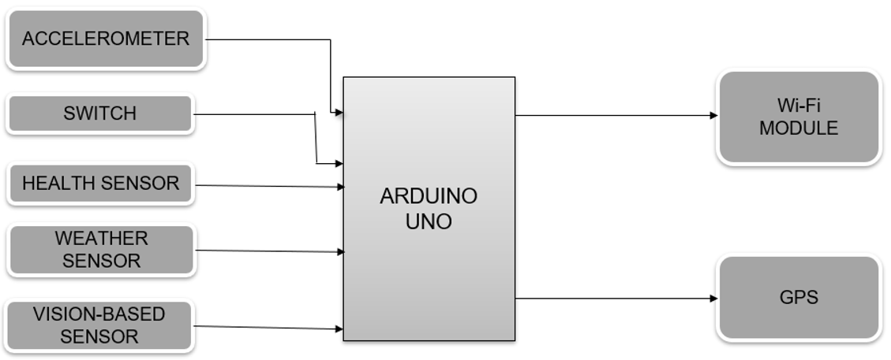
WORLD IoT DAY 2022
Block Diagram

Slide 9
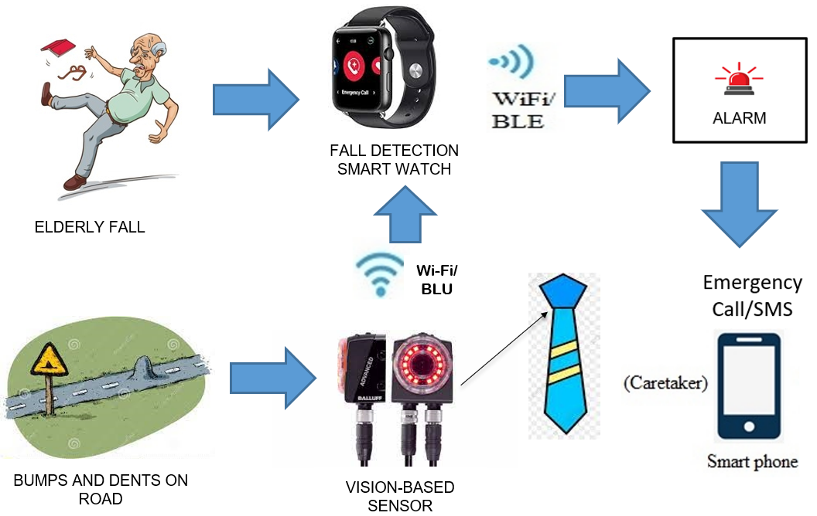

WORLD IoT DAY 2022
Block Diagram

Slide 10
WORLD IoT DAY 2022
Implementation Plan/Working Model
When the accelerometer detects a quick increase or decrease in tilt compared to the fixed threshold, this prototype model detects the fall.
The device will wait for the user to confirm or decline the fall by pressing the inbuilt switch within 30 seconds. If the fall is confirmed or the countdown is complete, an SOS message and phone calls are sent to the emergency contacts, and the alarm is set high enough to be heard by someone close to get help.
To communicate the notice and location, the Wi-Fi module is connected to the device via a consistent Wi-Fi connection.

Slide 11
WORLD IoT DAY 2022
Validation / Testing / Analysis
According to the results of the testing, this project allows us to detect falls with more precision and fewer false alarms.
This prototype has addressed the majority of the issues raised.

Slide 12
WORLD IoT DAY 2022
Cost Estimate
An educated guess of the cost is made as the project work has just begun.
WBS ITEMS | COST (PER ITEM) | ACCURACY (IN %)
HARDWARE | $50.20
SOFTWARE | $40.12
TRAINING | $10
TESTING | $33
TOTAL PROJECT COST ESTIMATE | $133.32 | 75%

Slide 13

WORLD IoT DAY 2022
Working video Link
As the project is in the beginning stage, a prototype model is used to explain the working.

Slide 14
WORLD IoT DAY 2022
References
1] L. Jian and T. E. Lockhart, "Development and Evaluation of a Prior-to-Impact Fall Event Detection
Algorithm," Biomedical Engineering, IEEE Transactions on, vol. 61, pp. 2135-2140, 2014.
[2] P. Pierleoni, A. Belli, L. Palma, M. Pellegrini, L. Pernini, and S. Valenti, "A High Reliability Wearable
Device for Elderly Fall Detection," Sensors Journal, IEEE, vol. 15, pp. 4544-4553, 2015.
[3] R. Freitas, M. Terroso, M. Marques, J. Gabriel, A. Torres Marques, and R. Simoes, "Wearable sensor
networks supported by mobile devices for fall detection," in SENSORS, 2014 IEEE, 2014, pp. 2246-2249.
[4] Z. Xiaodan, H. Jing, G. Potamianos, and M. Hasegawa-Johnson, "Acoustic fall detection using
Gaussian mixture models and GMM supervectors," in Acoustics, Speech and Signal Processing, 2009.
ICASSP 2009. IEEE International Conference on, 2009, pp. 69-72.
[5] L. Yun, K. C. Ho, and M. Popescu, "Efficient Source Separation Algorithms for Acoustic Fall Detection
Using a Microsoft Kinect," Biomedical Engineering, IEEE Transactions on, vol. 61, pp. 745-755, 2014.
[6] M. Yu, S. M. Naqvi, A. Rhuma, and J. Chambers, "One class boundary method classifiers for
application in a video-based fall detection system," Computer Vision, IET, vol. 6, pp. 90-100, 2012.
[7] E. E. Stone and M. Skubic, "Fall Detection in Homes of Older Adults Using the Microsoft Kinect,"
Biomedical and Health Informatics, IEEE Journal of, vol. 19, pp. 290-301, 2015.

Slide 15

WORLD IoT DAY 2022
THANK YOU

